Slide 1

Science Gateway Architectures: Applied Open Source, Distributed Computing
Marlon Pierce, Suresh Marru
Science Gateways Research Center, Indiana University
marpierc@iu.edu, smarru@iu.edu

Slide 2
B649 Special Topics Course: Fall 2017
For syllabus information and presentation material, see the course website
http://courses.airavata.org
For project assignments and other communications, use Canvas

Slide 3
What Is a Science Gateway?
A Science Gateway is a user-centric environment for conducting online computational scientific research

Slide 4
What if Mark Zuckerberg Read More Chemistry and Biology Books?

Slide 5
What Is a Science Gateway?

Slide 6

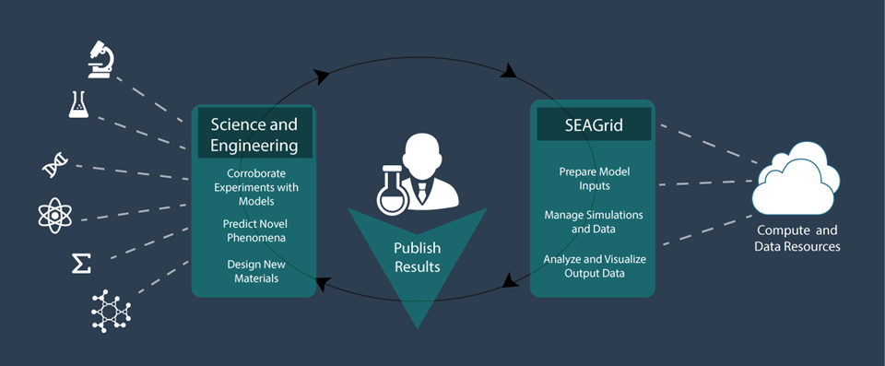
SEAGrid.org is an Apache Airavata-powered gateway

Slide 7
Hydrated Calcium Carbonate in Action

Slide 8
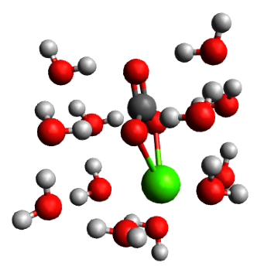
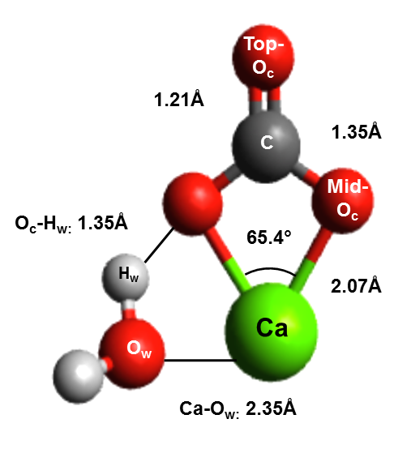
What is the chemistry of hydrated calcium carbonate?
Bio-mineralization of skeletons and shells
Geological C02 sequestration
Cleanup of contaminated environments
Lopez-Berganza, et al. J Phys. Chem. A(2015)
CaCO3.1H2O
CaCO3.12H2O
Notes:
If we go back to the earliest stages, during the ion pair formation, it is believed that the hydration shell around these minerals can dictate which pathway to is followed. Of course, study of hydration shell is challenging in the lab, so we rely on computational chemistry. For this particular study, we focused on thoroughly characterizing the hydration shell of calcium carbonate at different hydration levels. We hydrated a single molecule. We work with static structures. One of the practical challenges of this is how do we place water molecules to find the equilibrium states?
Biomineralization is a process by which minerals from nature are incorporated into biological systems for a variety of functions. Calcium carbonate is an abundant mineral extracted from calcium and carbonate ions in solution and used by many organisms to support critical functions such as structural entities such as skeletal systems and functional entities as protective layers. A specific aspect of self-healing of these tissues is interesting and should be applicable in engineered processes. In this study, we attempt to provide the thermodynamics of hydration of the mineral calcium carbonate in terms of the water coordination and ionic interactions. Ab initio quantum chemical simulations of large hydrated calcium carbonate clusters are challenging due to the existence of multiple local energy minima. SEAGrid Science Gateway and the applications deployed and provided to the community were used for this project for preprocessing, computations and post processing work.
Extensive conformational searches around hydrated calcium carbonate clusters (CaCO3·n H2 O for n = 1− 18) were performed to find low-energy hydration structures using an efficient combination of Monte Carlo searches, density-functional tight binding (DFTB +) method, and density-functional theory (DFT) at the B3LYP level, or Møller−Plesset perturbation theory at the MP2 level. This multilevel optimization yields several low-energy structures for hydrated calcium carbonate. Structural and energetics analysis of the hydration of these clusters revealed a first hydration shell composed of 12 water molecules. Bond-length and charge densities were also determined for different cluster sizes. The solvation of calcium carbonate in bulk water was investigated by placing the explicitly solvated CaCO3·n H2 O clusters in a polarizable continuum model (PCM) of water. The findings of this study provide new insights into the energetics and structure of hydrated calcium carbonate and contribute to the understanding of mechanisms where calcium carbonate formation or dissolution is of relevance.

Slide 9

CaCO₃.xH₂O Initial guess
SEAGrid.org enabled workflow
Stampede Supercomputer
TINKER
Monte Carlo Molecular Mechanics
(Minimize Torsional Energy in <20,000 steps)
Stampede Supercomputer
DFTB+
Approximate DFT-Based
x=x+1
-2-3 CaCO3 Equilibrium Structures
-Thermochemistry (E,H,G, etc.)
-Vibrational Frequencies
Comet Supercomputer
Gaussian09
Ab initio Quantum Chemistry
Lopez-Berganza, et al. J Phys. Chem. A(2015)
Notes:
Our approach uses a combination of MM to identify low energy candidates(which avoids any water placement bias). These candidates were then further optimized with more rigorous methods(DFTB+ and Gaussian 09). This approach gave us not only equilibrium structures, but also the thermochemistry of the clusters.

Slide 10
Browser
HTTPS
Web Interface Server
Client SDK
HTTP or TCP/IP
Server SDK
Application Server
Resource Plugins
IU: Big Red 2
XSEDE: Stampede
XSEDE: Comet
Juelich: Jureca

Slide 11
Browser
Facebook doesn’t look like this, so why should science gateways?
HTTPS
Web Interface Server
Client SDK
HTTP or TCP/IP
Server SDK
Application Server
Resource Plugins
IU: Big Red 2
XSEDE: Stampede
XSEDE: Comet
Juelich: Jureca

Slide 12
Challenges for Science Gateways
Providing a rich user experience
Defining an API for the application server
Defining the right sub-components for the application server.
Implementing the components, wiring them together correctly.
Supporting multiple gateway tenants
Fault tolerance for components
State management
Continuous delivery
Security management
Supporting full scientific exploratory cycle

Slide 13
Goal 1: Apply basic distributed computing concepts to Science Gateways.

Slide 14
Goal 2: Apply new architectures, methodologies, and technologies to Science Gateways: Microservices, DevOps

Slide 15
Goal 3: Teach open source software practices

Slide 16
Developing Computational Science Gateways using Apache Airavata

Slide 17
What Is Apache Airavata?
Open source middleware to support Science Gateways
Compose, manage, execute, and monitor distributed, computational workflows
Wrap legacy command line scientific applications with Web services.
Run jobs on computational resources ranging from local resources to computational grids and clouds
Record, preserve, search, and share metadata about computational experiments
Hosted version of Apache Airavata provides multi-tenanted Platform as a Service.
SciGaP

Slide 18
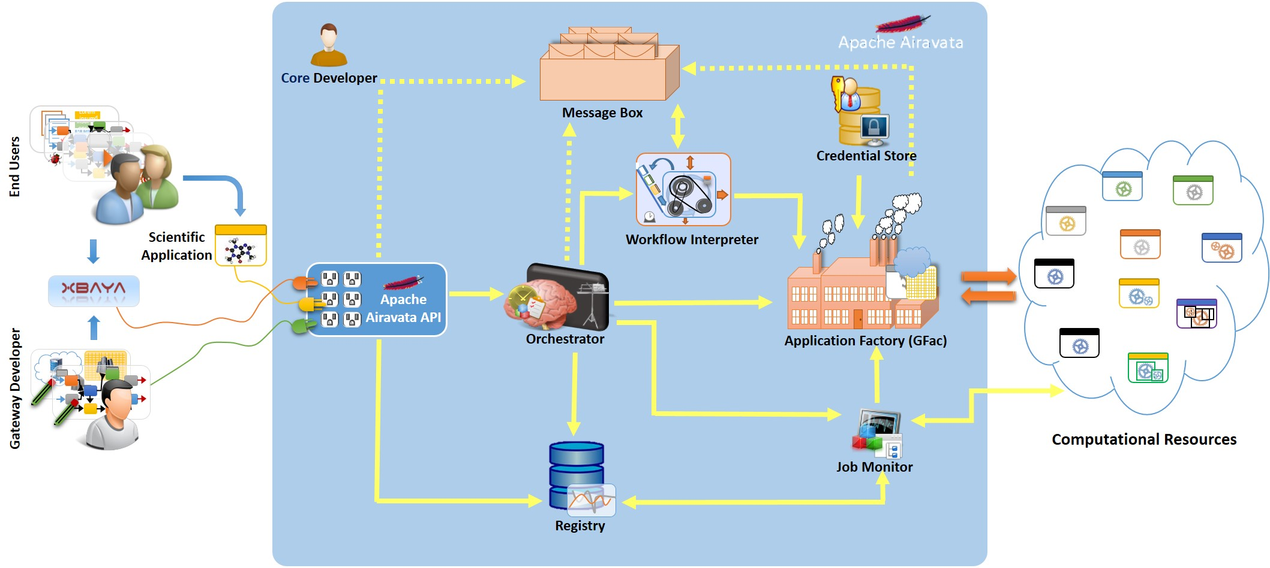
Airavata Components

Slide 19
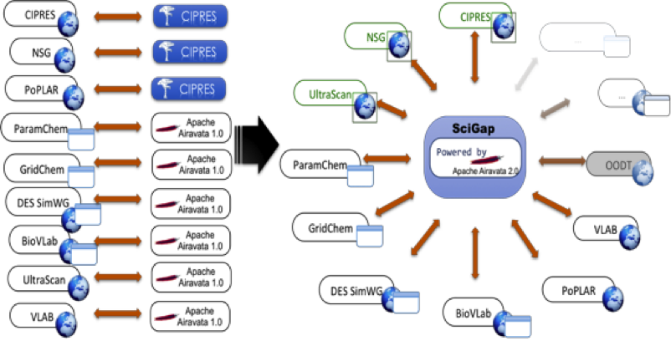
Airavata as a Service: SciGaP

Slide 20
Structure of the Course
All students work individually
80% of your grade is from homework submissions
20% comes from mid-term and final presentations and reports
Everyone will have a github repository within the https://github.com/airavata-courses organization
See the syllabus (courses.airavata.org) for more details
We will provide you with Jetstream accounts that can be used to create VMs for running your services.
http://courses.airavata.org/

Slide 21
Project Grading
Each project is assigned for 2 weeks and worth 10 points
8 assignments
You get 8 points for your submission and 2 points for peer reviewing 2 other submissions
For each assignment
Week 1: You must submit your project by Monday midnight of the first week
Week 2: Peer reviewers are assigned on Tuesday and must complete by Monday midnight of second week
Decision: each peer either approves or disapproves the submission
At least one approval is needed before the GAs will grade
Use GitHub issues for peer reviews and approvals
Tuesday of Week 2: course GAs start grading all approved assignments
If the grader executes the assignment, the submitter gets 8 points and the peer reviewers each get 1 point
If not, the submitter loses 8 points and the approving reviewers lose 1 point
Peer reviewers who disapprove an assignment get their points

Slide 22
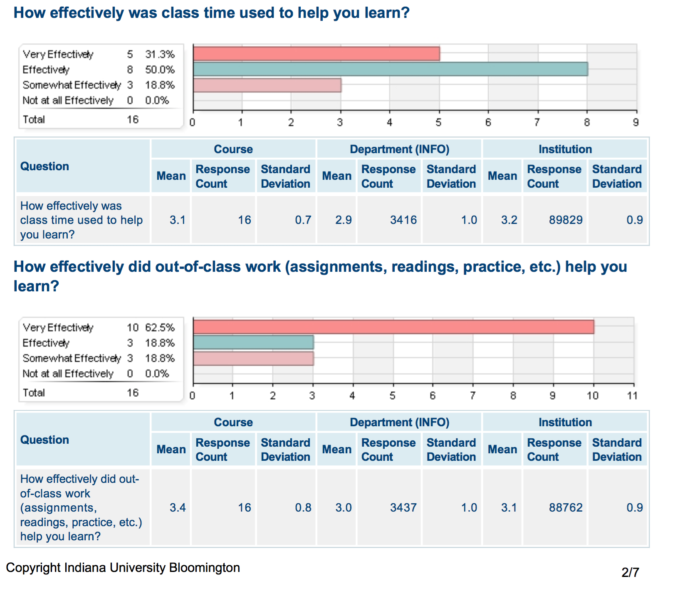
Learning occurs outside the classroom.

Slide 23
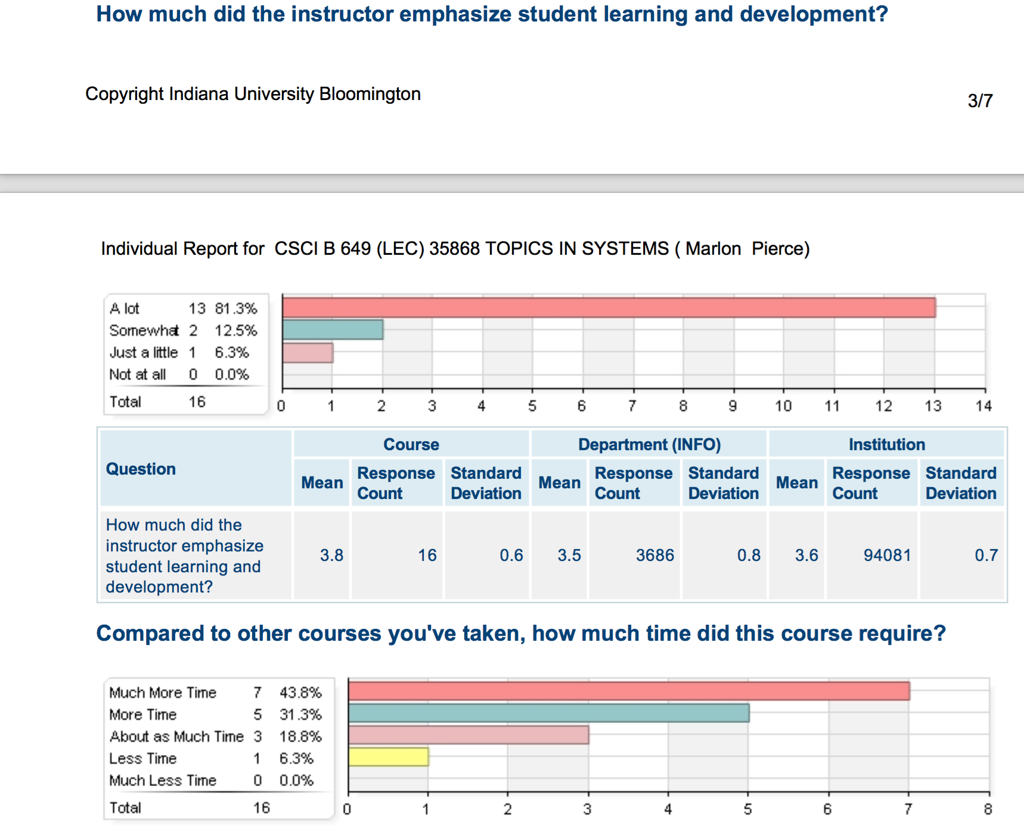

Slide 24
What You Need to Do Before Thursday
Create a GitHub account if you don’t have one
Send us your GitHub user name so that we can add you to the Airavata Courses GitHub organization
Go to https://portal.xsede.org/ and create an account
Send us your user name
If possible, please make these user names consistent with your IU network ID.
Submit this through Canvas (0-point assignment)

Slide 25
More Information
Contact:
marpierc@iu.edu, smarru@iu.edu
Join dev@airavata.apache.org, users@airavata.apache.org, architecture@airavata.apache.org
Websites:
Apache Airavata: http://airavata.apache.org

Slide 27
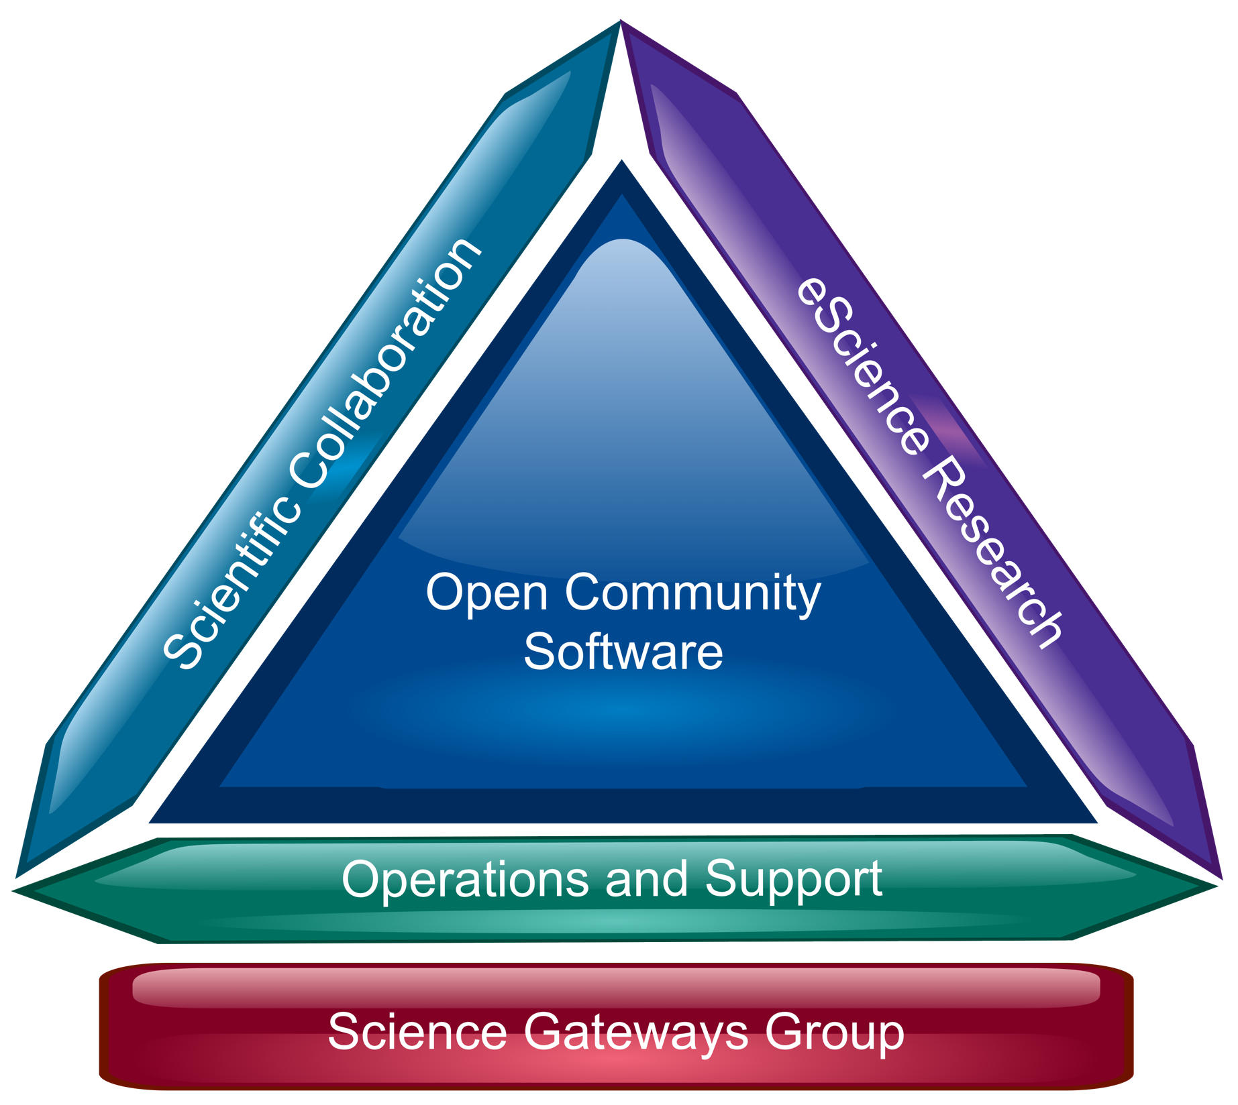
A Balancing Act

Slide 28
What is Cyberinfrastructure?
Scientific Distributed Computing

Slide 29
What Is Cyberinfrastructure?
“Cyberinfrastructure consists of computing systems,
data storage systems, advanced instruments and
data repositories, visualization environments, and
people, all linked together by software and high
performance networks to improve research
productivity and enable breakthroughs not otherwise
possible.”
–Craig Stewart, Indiana University

Slide 30
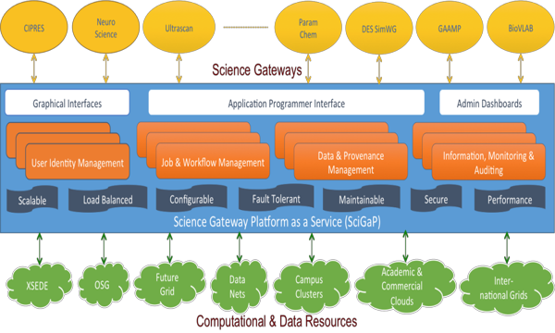
SciGaP Role and Goals: Improve sustainability by converging on a single set of hosted infrastructure services

Slide 31
Cyberinfrastructure Layers
User Interfacing Services
Web/Gadget Container
Web/Gadget Interfaces
Web Enabled Desktop Applications
Gateway Abstraction Interfaces
Application Abstractions
Fault Tolerance
Monitoring
User Management
Information Services
Gateway Services
Workflow System
Auditing & Reporting
Registry
Security
Provenance & Metadata Management
Resource Middleware
Cloud Interfaces
Grid Middleware
SSH & Resource Managers
Compute Resources
Computational Clouds
Computational Grids
Local Resources
Color Coding
Airavata components
Complimentary gateway components
Dependent resource provider components
Notes:
Is Job submission understood to be part of Workflow? Maybe it should be called out, if it is.
Is Monitoring the same as "User monitoring"?
Fault tolerance includes: failover when preferred host isn't available? what happens when data transfer resource fails? other things?

